Slide 1

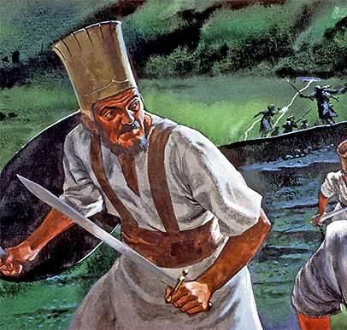
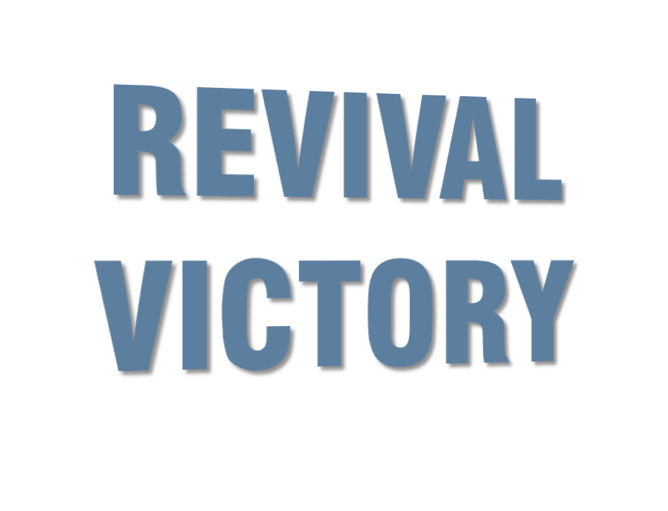


Slide 2
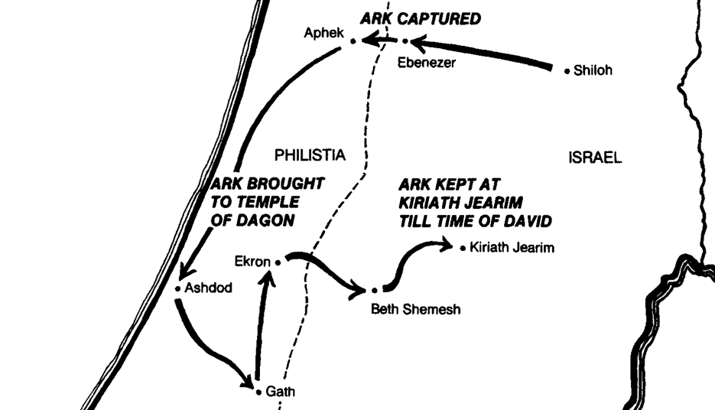

Slide 3
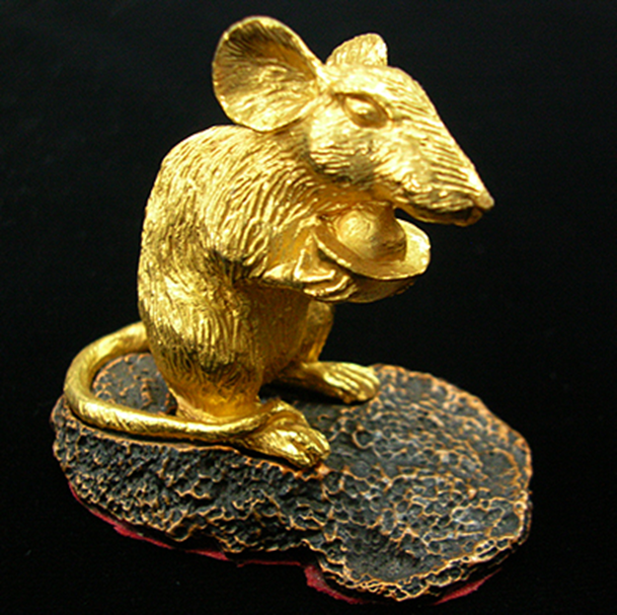
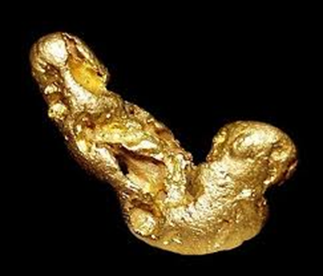
The Sad Solution?
More presumption. Strike 1!
Call for the ministers of Dagon.
Strike 2!
They decide to GET RID of God rather than GET RIGHT with God! Strike 3!
This is the problem with the mentality of the lost mind; it wants God to just “go away and leave me alone!”

Slide 4
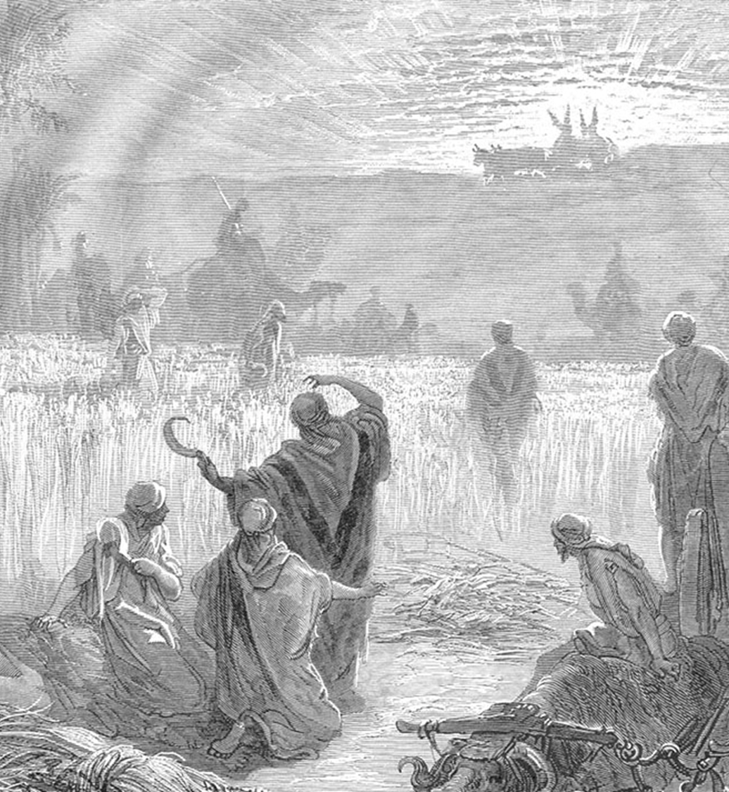
Restoration was needed!
Abinadab =
“father of generosity!”
Eleazar = “God is helper!”
They want God’s presence with them!

Slide 5
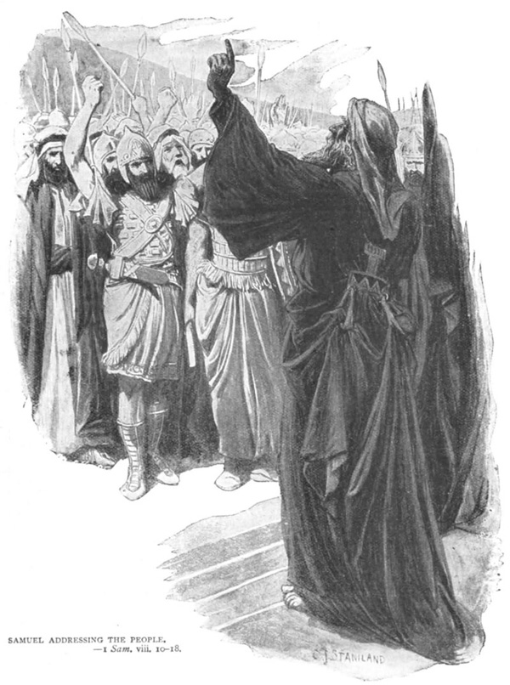
We need submission to the Lord.
We need a word from the Lord – Samuel has it.
To see revival and God’s deliverance in our lives, our God MUST have no other before Him!

Slide 6
Exodus 20:3 Thou shalt have no other gods before me.

Slide 7
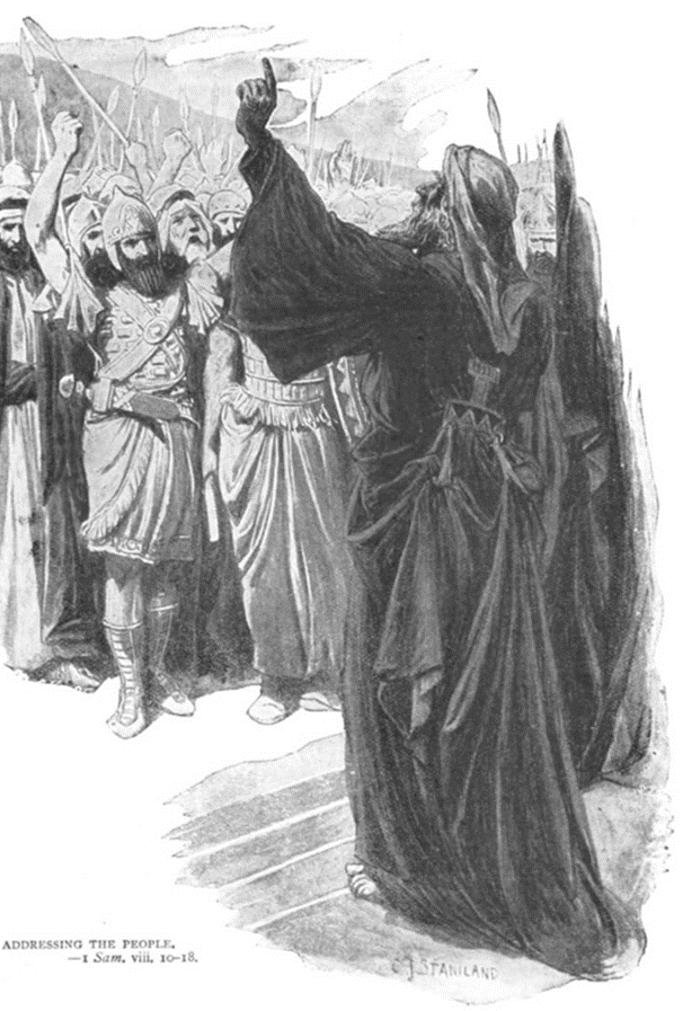
If you are here, holding out against God to hold on to your sin, then you are that much a measure that is holding this church back from all that God intends her to be!

Slide 8
Isa 55:7 Let the wicked forsake his way, and the unrighteous man his thoughts: and let him return unto the LORD, and he will have mercy upon him; and to our God, for he will abundantly pardon.

Slide 9
2 Chronicles 7:14 If my people, which are called by my name, shall humble themselves, and pray, and seek my face, and turn from their wicked ways; then will I hear from heaven, and will forgive their sin, and will heal their land.

Slide 10
Matthew 22:37 Jesus said unto him, Thou shalt love the Lord thy God with all thy heart, and with all thy soul, and with all thy mind.

Slide 11
We need to humble ourselves in prayer.
Mizpeh = “watch tower.”
We have to come together in prayer!

Slide 12
James 5:16 Confess your faults one to another, and pray one for another, that ye may be healed. The effectual fervent prayer of a righteous man availeth much.

Slide 13
We need to humble ourselves in prayer.
Mizpeh = “watch tower.”
We have to come together in prayer!
Pouring out water = a picture of dependence on the Word of God. Eph 5:25
Fasting = a picture of recognizing that there is no solution in the flesh.

Slide 14
We need to confess our sin against God.

Slide 15
2 Chronicles 7:14 If my people, which are called by my name, shall humble themselves, and pray, and seek my face, and turn from their wicked ways; then will I hear from heaven, and will forgive their sin, and will heal their land.

Slide 16
Leviticus 26:40-45 If they shall confess their iniquity, and the iniquity of their fathers, with their trespass which they trespassed against me, and that also they have walked contrary unto me; 41 And that I also have walked contrary unto them, and have brought them into the land of their enemies; if then their uncircumcised hearts be humbled, and they then accept of the punishment of their iniquity: 42 Then will I remember my covenant with Jacob, and also my covenant with Isaac, and also my covenant with Abraham will I remember; and I will remember the land. 43 The land also shall be left of them, and shall enjoy her sabbaths, while she lieth desolate without them: and they shall accept of the punishment of their iniquity: because, even because they despised my judgments, and because their soul abhorred my statutes. 44 And yet for all that, when they be in the land of their enemies, I will not cast them away, neither will I abhor them, to destroy them utterly, and to break my covenant with them: for I am the LORD their God. 45 But I will for their sakes remember the covenant of their ancestors, whom I brought forth out of the land of Egypt in the sight of the heathen, that I might be their God: I am the LORD.

Slide 17
Psalm 51:1-4 Have mercy upon me, O God, according to thy lovingkindness: according unto the multitude of thy tender mercies blot out my transgressions. 2 Wash me throughly from mine iniquity, and cleanse me from my sin. 3 For I acknowledge my transgressions: and my sin is ever before me. 4 Against thee, thee only, have I sinned, and done this evil in thy sight: that thou mightest be justified when thou speakest, and be clear when thou judgest.

Slide 18
1 John 1:9 If we confess our sins, he is faithful and just to forgive us our sins, and to cleanse us from all unrighteousness.
Psalm 66:18 If I regard iniquity in my heart, the Lord will not hear me:

Slide 19
Ps 23:1-6 The LORD is my shepherd; I shall not want. 2 He maketh me to lie down in green pastures: he leadeth me beside the still waters. 3He restoreth my soul: he leadeth me in the paths of righteousness for his name's sake. 4 Yea, though I walk through the valley of the shadow of death, I will fear no evil: for thou art with me; thy rod and thy staff they comfort me. 5 Thou preparest a table before me in the presence of mine enemies: thou anointest my head with oil; my cup runneth over. 6 Surely goodness and mercy shall follow me all the days of my life: and I will dwell in the house of the LORD for ever.

Slide 20
The enemy hates revival!
When your heart is miserable, and far from God, the devil leaves you alone!
But if you abide in Christ – Satan works to short out any connection to fruit bearing.

Slide 21
Psalm 20:7 Some trust in chariots, and some in horses: but we will remember the name of the LORD our God.
James 4:7 Submit yourselves therefore to God. Resist the devil, and he will flee from you.

Slide 22
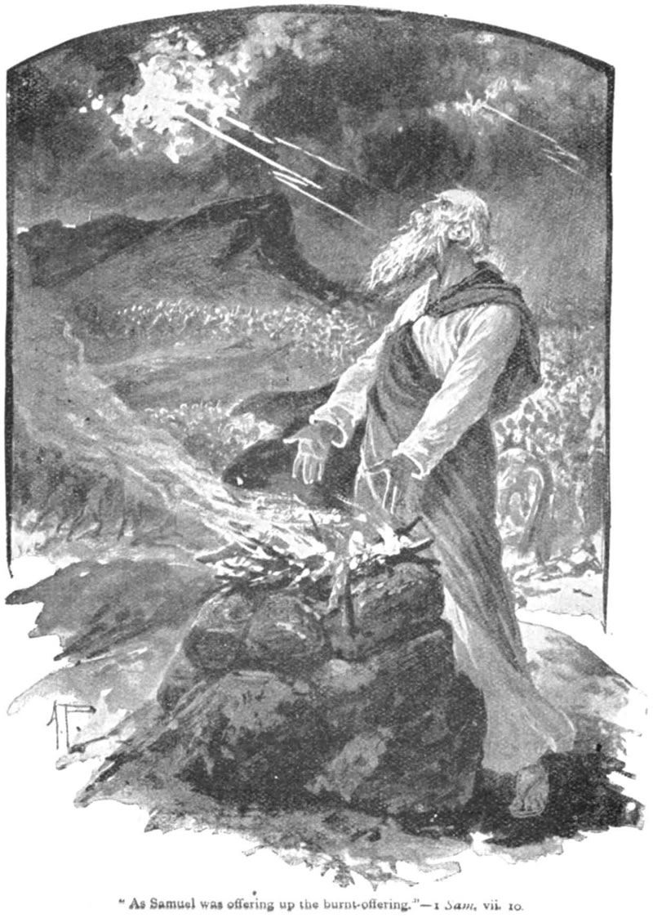
God is our salvation!
The picture: Key to victory?
The sacrifice of God – the finished work of Calvary.

Slide 23
John 1:29 The next day John seeth Jesus coming unto him, and saith, Behold the Lamb of God, which taketh away the sin of the world.
Romans 8:31-32 What shall we then say to these things? If God be for us, who can be against us? 32 He that spared not his own Son, but delivered him up for us all, how shall he not with him also freely give us all things?

Slide 24
God is our salvation!
Thru THE Sacrifice we have victory over the devil.
Think about the contrast!
Samuel accomplished more by leading God’s people into REPENTANCE and PRAYER (vs 3-6) than Samson did in 20 years of STRIVING after the flesh.

Slide 25
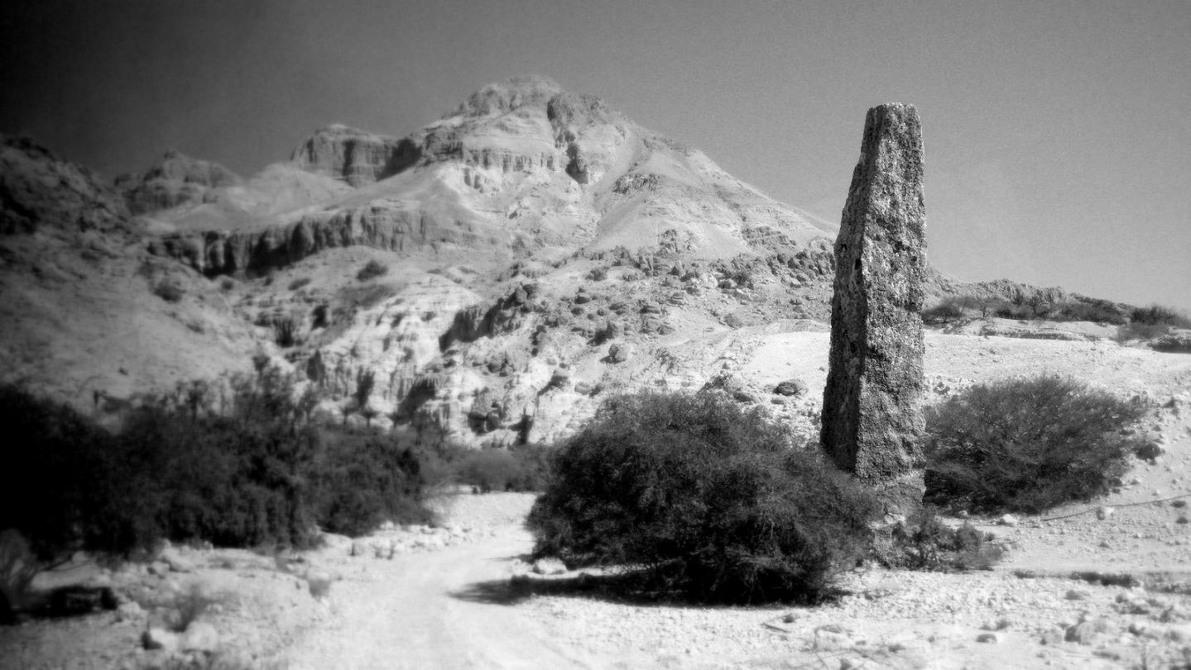
Get right with God and get to writing it down.

Slide 26
Dependence in prayer is the ultimate position of power!

